Slide 1
ESSA Updates
Cory Green, Associate Commissioner
Contracts, Grants and Financial Administration
Texas Education Agency
© 2018, Texas Education Agency

Slide 2
2018-2019 Appropriation Estimates
Title I, Part A – 4.1% increase
Migrant – 10% decrease
Title I, Part D – 0.7% decrease
Title II, Part A – 4.7% increase
Title III, Part A – 8.9% decrease
Title IV, Part A – 1.5% decrease
Notes:
4.7% increase for Title II
Another 10% decrease next year for Migrant

Slide 3
2018-2019 Appropriation Estimates
Rural, Low Income – 0.5% decrease
Homeless – 3.9% increase
IDEA – 0.1% increase
Perkins – 0.4% increase
Notes:
4.7% inc

Slide 4
2019-2020 Budget Proposal
Proposes zero funding
Title II, Part A
21st CCLC
Title IV, Part A

Slide 5
Validations to be Public

Slide 6
Random Validations
Lists will be released to public upon request
May soon post to website
Notes:
First time the lists will be released, along with the worksheet of what we are looking for. Public requests: will release findings.

Slide 7
PS3001 Update

Slide 8
SC3001—Needs Assessment, Priorities, and Program Outcomes— Reporting for ESSA and Perkins Federal Grant Programs

Slide 9
2017−2018 ESSA Consolidated Applications
First year of ESSA implementation:
ESSA Program Schedule PS3001—Needs Assessment Priorities, and Program Outcomes:
Identify and prioritize needs;
Implement programs addressing priority needs;
Align programs and activities to TEA Strategic Priorities; and
Develop 3 to 5 student outcome-focused SMART goals.
2017-2018

Slide 10
PS3001: Year One Activities
Add PS3001/PS3002 to ESSA-funded grant applications;
Identify additional federal grants for year two;
Publish ESSA and PS3001 resources for ESCs and LEAs;
Provide ESCs and LEAs training; and
Monitor year-one implementation.

Slide 11
Year Two: SC3001 for ESSA and Perkins
Eliminate duplication
Change deadlines to better address data availability: End of September
Encourage LEAs to have one plan for all federally-funded programs
Reduce possible delays in grant negotiation
Make SC3001 function more like a CIP
Use the new eGrants system currently implemented for ESSA
Prepopulated from 2017-2018 ESSA PS3001
Notes:
App deadline: End of September, so districts can have data available;
SMART Goals: Expectation is for them to be the same and just adjust annual target on the new school year;

Slide 12
Year Two: SC3001 for ESSA and Perkins
SC3001: Needs Assessment, Priorities, and Program Outcomes
LEAs use information in ESSA and Perkins applications to:
Connect activities in ESSA and Perkins Local Plans; and
Show how they are coordinating use of ESSA and Perkins funds.

Slide 13
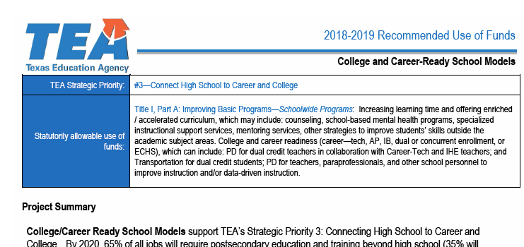
Resources for LEAs
Notes:
For SSAs: They need to complete their own 3001 with their own goals and activities; the ESC will not complete this for them.

Slide 14
One Application

Slide 15
One Mega-Application
ESSA
Perkins
IDEA
Notes:
Goal: 2019-2020
Maybe: 2020-2021

Slide 16
Private Nonprofit Schools

Slide 17
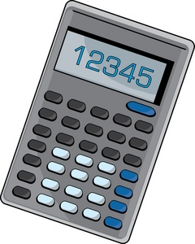
PNP Equitable Services
Notes:
Early April: Releasing PNP Equitable Amount Calculator (Not eGrant)

Slide 18
PNP Equitable Services
Statewide Trainings
Late April, May
Dallas, Austin, San Antonio, Houston

Slide 19
Cory Green, Associate Commissioner Contracts, Grants and Financial Administration Texas Education Agency (512) 463-8992 cory.green@tea.texas.gov

